Slide 1

Municipality of Posušje
Investment opportunities
We are here for You!

Slide 2
Municipality of Posušje in numbers

Slide 3
Why to invest in Municipality of Posušje?
Favourable geo-traffic position
Reach natural resources and business tradition
Available business infrastructure
Young, qualitified and cost competitive labour force
Fast and efficient municipal administration
Quality of life
Competitive business environment in BIH

Slide 4
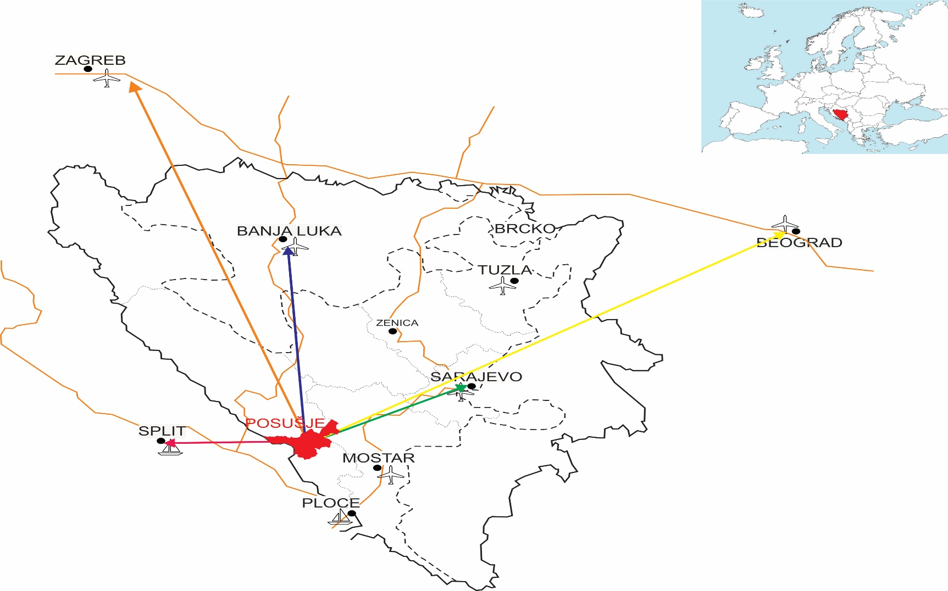
Favourable geo-traffic position

Slide 5
Favourable geo-traffic position
At intersection of regional roads
1 km to border with Croatia (EU)
30 km to Highway A1 (Zagreb-Dubrovnik), part of future Adriatic-Ionian corridor
Vicinity to future pan-european Corridor 5C
International sea port Ploče (67km), Split (99 km), international aeroport Split (109km)
EU market: more than 500 million inhabitants

Slide 6
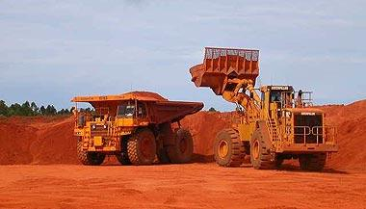
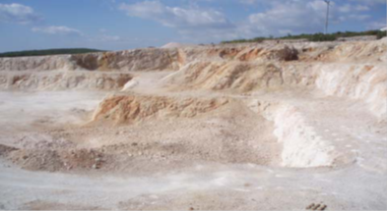
Reach natural resources and industrial tradition
Mineral resources – bauxite (over 3 mil tons in reserves), 10 types of stone of high architectural and construction value, marl
40.216 ha of pastures (goat and sheep breeding)
Multy-year average of 2.200 sunny hours
Nature park Blidinje
Tradition in industrial production (metal, plastic and stone processing), meat and diary industry

Slide 7
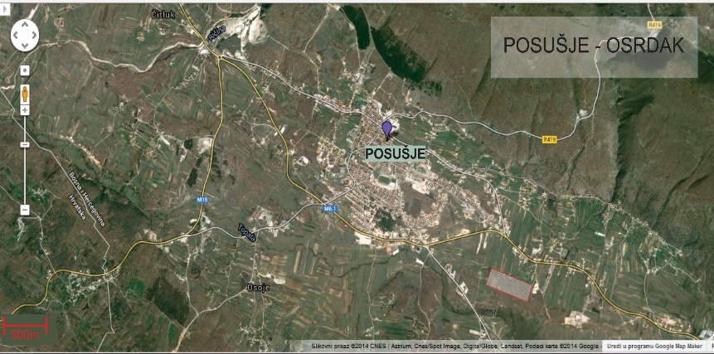
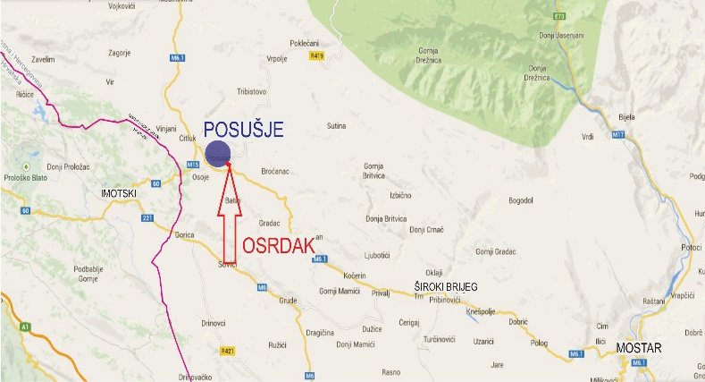
Available business infrastructure
Business zone Osrdak
  Along main road Posušje-Mostar
  Size: 13,74 ha
  Available 16 plots of 4.000m2 average size
  Price: 1 BAM/m2 (0,5 EUR/m2)
  Services land with infrastructure
  Purpose: SMEs, environmentally friendly production and services

Slide 8
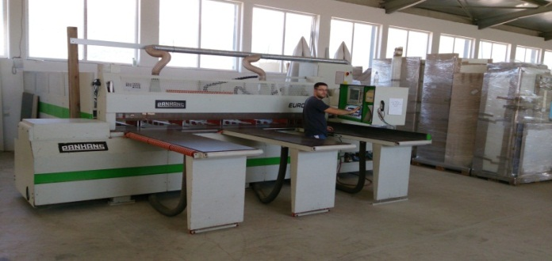
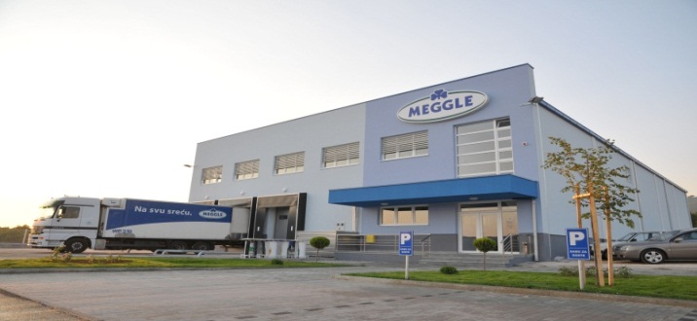
Available business infrastructure
Business zone Osrdak
  5 companies, 128 employees
  Diary industry (Meggle, Germany), production of furniture for exports, construction, production of pens and pencils
Target sectors: production of food, stone production and processing, metal and machinery industry

Slide 9

Meggle in Posušje
Market leader in milk and diary products in BIH
Logististics and distribution centre for Southeast Europe opened on 14.9.2011.g. in Business zone Osrdak
Investment value: more than 1 million EUR
Logistics and distribution center: 10.000 m2, warehouse and office space: 1.300 m2
Employees: 60
Developed cooperation with local cattle breeders and milk producers
Current purchase of 100.000 l/month
Aimed increase to 1-1,5 mil l/month

Slide 10

What investor said about us
„Based on our business needs we approached the Municipality of Posušje in 2011 with the aim to build our new logistics and distribution centre for BIH, neighbouring countries and Southeast Europe. To our satisfaction, the municipal administration in short term provided all necessary preconditions to start building our centre in the Business zone Osrdak in Posušje.
I hereby wish to express my satisfaction with business conditions offered by the Business zone Osrdak and the Municipality of Posušje. Company Meggle d.o.o. opened the logistics and distribution centre in 2011 and successfully operates since then.“
Director: Jadranka Penava

Slide 11
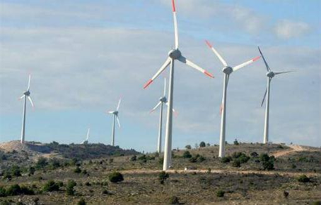
Available business infrastructure
Business zone Vlake
  Along main road Posušje-Tomislavgrad
  Size: 190,38 ha
  Purpose: production companies (plastics, construction, stone...)
8 companies, 163 employees
Zone Zavelim (200ha), Osoje (100ha), Oštrc, Poklečani
  Purpose: solar fields and wind parks

Slide 12
Incentives for investitors
Atractive local incentives:
  Price of building land 1BAM/m2 (0,5 EUR/m2)
  2-year exemption from communal fee for newly build business facilities
2 days for issuance of documentation under municipal jurisdiction
Competitive business environment in BIH:
  Profit tax 10%
  Value added tax (VAT) 17%
  Income tax 10%
National tax and customs incentives for foreign investors

Slide 13
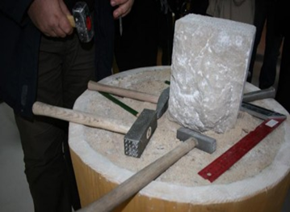
Young and qualified labour force
Available labour force (professional, technical and general skills)
Mostly young and working age population
Work tradition in agriculture, food processing, metal and machinery industry, plastics, stone processing, construction, services
Tradition in education and orientation towards entrepreneurial skills
Cost competitive labour force

Slide 14

Association of entrepreneurs Posušje
45 entrepreneurs with 2172 employees
550 mil KM (275 mil €) annual revenues (60% of total revenues of all companies in Municipality of Posušje)
Business cooperation opportunities with foreign and domestic investors

Slide 15
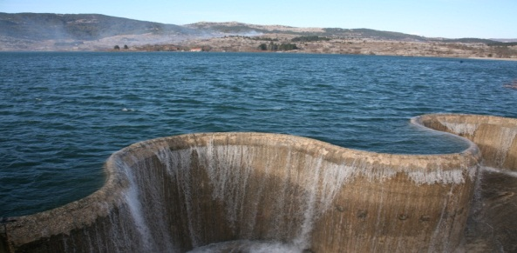
Quality of life
Safe working and living environment
Rich local gastronomy offer
Numerous all year posibilities for sports and recreation (skiing, golf, hiking and climbing...)
Cultural, sports and recreational events, entertainment
Proximity to Adriatic sea

Slide 16

Contact us
Professional, competent and efficient team of Municipality of Posušje
Is here for You!
Municipality of Posušje
Address: Fra Grge Martića 30, 88 240 Posušje, BIH
Telephone: ++ 387 (0)39 681035
Fax: ++387 (0)39 681041
E-mail: opcina.posusje.gs@tel.net.ba
Internet: http://www.posusje.ba

